Slide 1
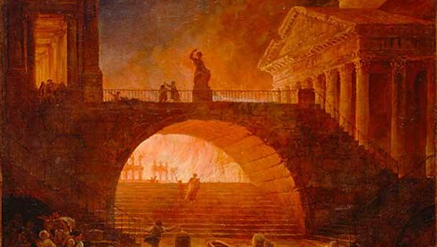
Encouragement to Be Faithful
2 Timothy 1:1 – 2:13
Great Fire of Rome (64 AD) – Hubert Robert C18th?

Slide 2
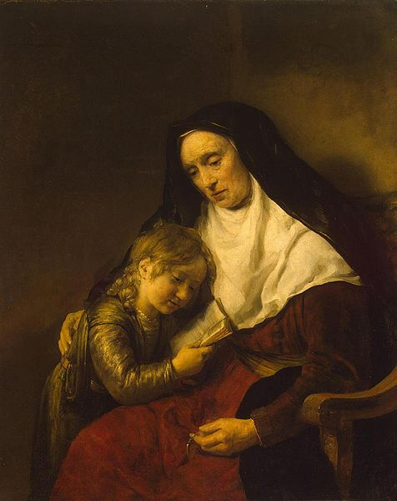
Timothy
From Lystra
Acts 16:1
Greek Father, Jewish Mother
Brought up Christian
2Tim 1:5
Timothy and Lois – Willem Drost - 1650s

Slide 3
Timothy and Paul
Met in Lystra?
Acts 14
Joined Paul in Mission - Reliable
Acts 16
Acts 17:14-15, 18:5, 19:22, 20:4
Close mentoring/teaching relationship
2Tim 3:10-11 - 1Tim 1:2, 2Tim 1:13 – “son”
Timothy led Ephesian church c64 AD
Big change for Timothy
2Tim 1:4, 1Tim 4:12
Chronic Illness?
1Tim 5:3, 2Cor 12:7

Slide 4
2 Timothy Written 65-68 AD?
Great Fire of Rome – 64 AD
Great Fire of Rome (64 AD) – Hubert Robert C18th?

Slide 5
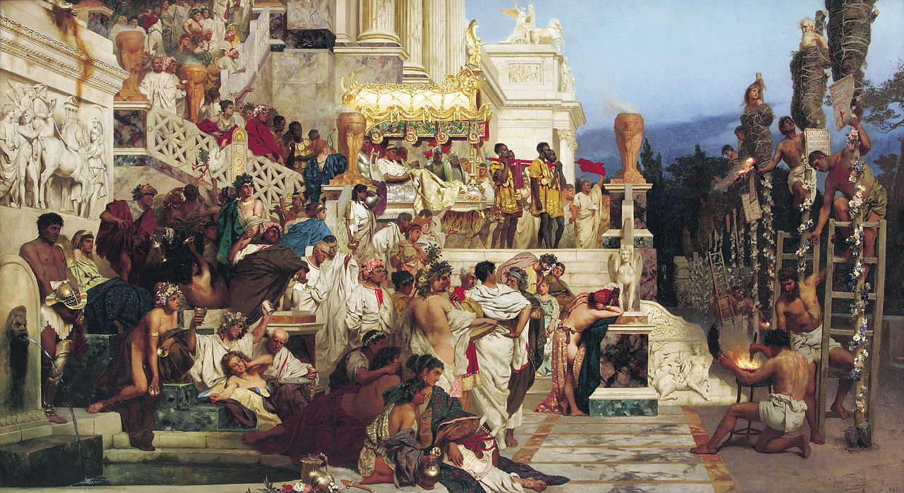
2 Timothy Written 65-68 AD?
Great Fire of Rome – 64 AD
First official Roman persecution of Christians
Nero Persecutes Christians – Henryk Siemiradzki – 1876

Slide 6
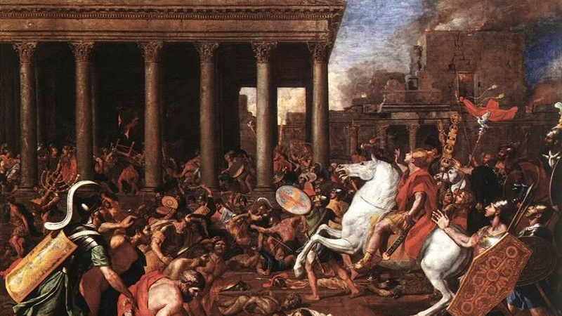
2 Timothy Written 65-68 AD?
Great Fire of Rome – 64 AD
First official Roman persecution of Christians
First Jewish-Roman War – 66-70 AD
Destruction of Jerusalem – Nicolas Poussin – 1637

Slide 7
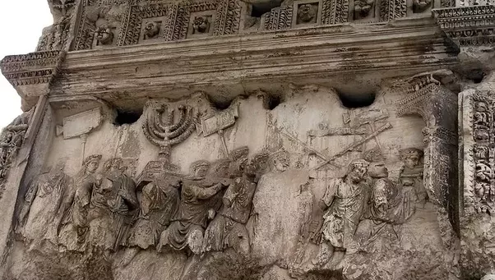
2 Timothy Written 65-68 AD?
Destruction of Jerusalem 70 AD
Mark 13
The Titus Arch – Rome

Slide 8
The Situation
Paul imprisoned in Rome
Kept ministering
2Tim 1:8, 2:9
In Ephesus…
…False teachers
2Tim 2:17-18
…Exploitation of vulnerable
2Tim 3:1-9
…People leaving faith
2Tim 1:18, 4:10, 4:16
…Opposition and hatred
2Tim 4:14
Paul in Prison – Rembrandt - 1627

Slide 9
Timothy’s Shoes?
Trusting God for the uncertainty ahead
Great Fire of Rome (64 AD) – Hubert Robert c18th?

Slide 10
Remember…
…Your place in God’s plan
…God purposes, not ours
1:3
Spiritual forerunners
2:9
1:9
Eternal salvation plan
1:5
Key people in your faith
…Stay Focussed
2:4
Who is in charge?
2:5
Keep the standards high
2:6
The greatest reward
Great Fire of Rome (64 AD) – Hubert Robert c18th?

Slide 11
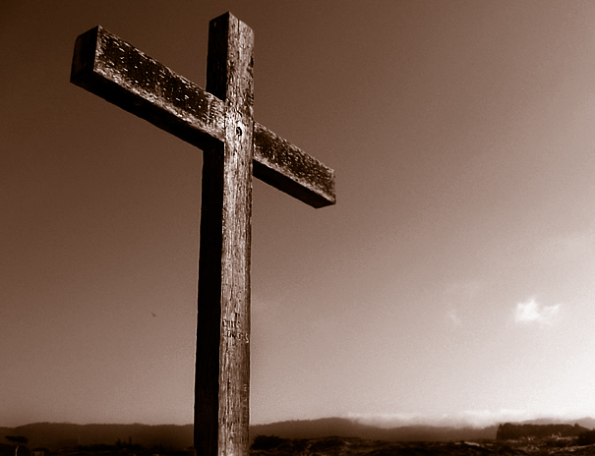
Remember…
…Your calling
…The Gospel
1:6-8
1:9-10
2:2-10
…Your gifting
1:6
…Grace
…The Holy Spirit
1:9, 2:1
1:7
Power
1:14
…Others
1:7
Love
2:2, 2:10
1:7
Self-Discipline
…God’s Faithfulness
2:13

Slide 12
Remember…

