Slide 1
People in Prayer: Paul
Ephesians 1: 15-23

Slide 2
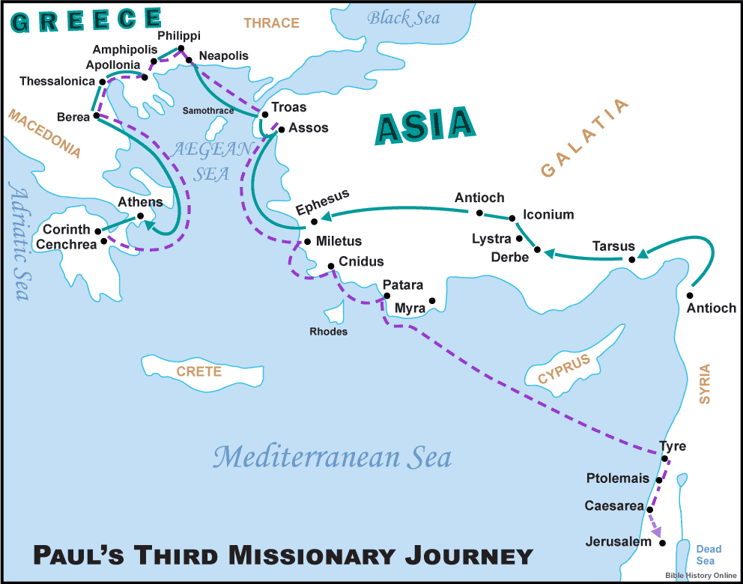

Slide 3
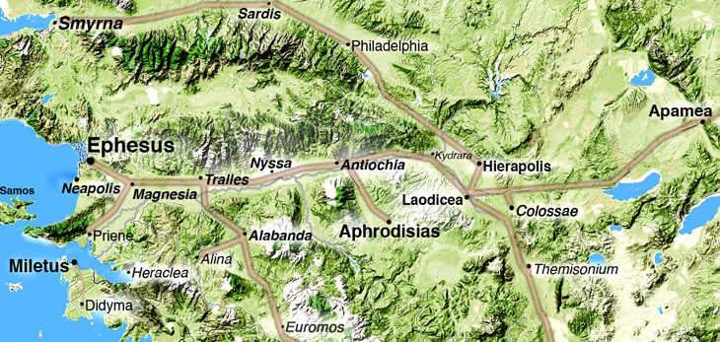

Slide 4
Key aspects
Why does Paul pray?
How does Paul pray?
What does Paul pray for?

Slide 5
Why does Paul pray?
Because God is incredible! (v3-14)
Because he’s heard of the faith and love of the believers

Slide 6
How does Paul pray?
Doesn’t stop giving thanks (v16) & keeps asking (v17)
Not crisis management
Not for specific circumstances

Slide 7
What does Paul pray for?
Three new realisations for the believers:
“I pray that the eyes of your heart may be enlightened so that you may know the hope to which He has called you.”
“… that you may know the riches of His glorious inheritance in His holy people.”
“… that you may know His incomparably great power for us who believe.”

Slide 8
God’s power
God raised Jesus
God exalted Jesus to the highest place
No other ruler, authority (power) can compare

Slide 9
www.thebibleproject.com

Slide 10
God’s presence
Jesus (the head) and us (believers) are intimately united
Christ’s home is within us (we are His address)
Together we’re being built into God’s living Temple

Slide 11
Four takeaways
We should pray for our fellow believers
Why we pray is important
Partly because of who God is
We should keep going
We should pray big prayers for each other

Slide 12
