Slide 1
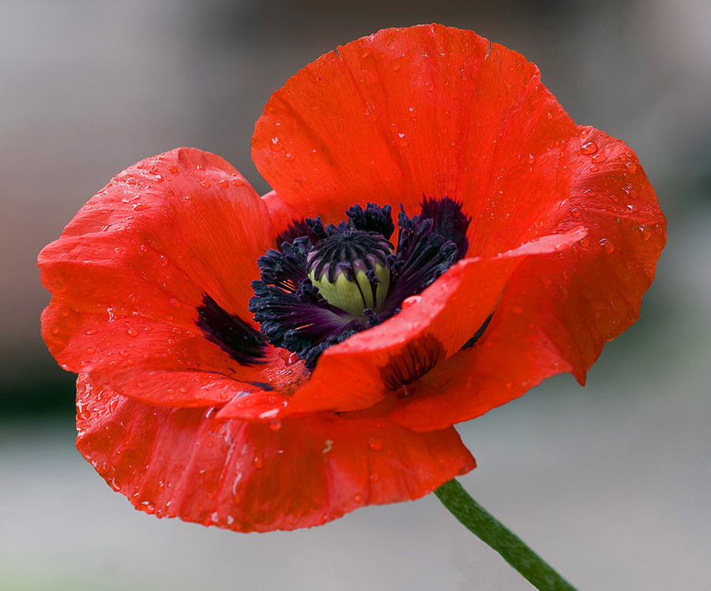
Remembrance Sunday The Cross of Christ Romans 5.1-11

Slide 2
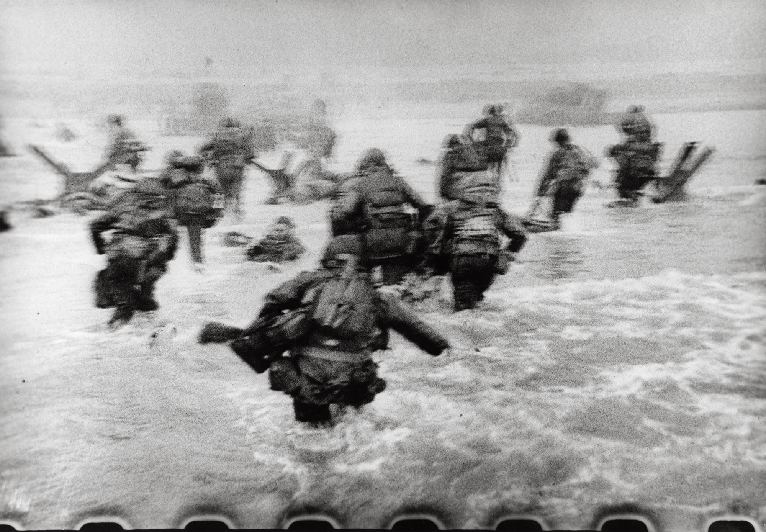
Appreciating the sacrifice

Slide 3
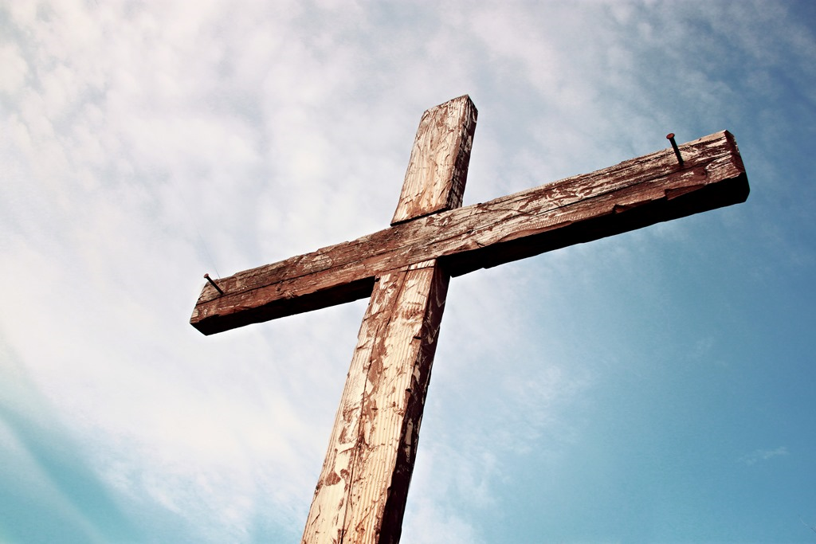
Appreciating the sacrifice of Christ
Romans 5.1-11, esp. vs 6-8
We were at war with God
But through his unrelenting grace he has saved us

Slide 4
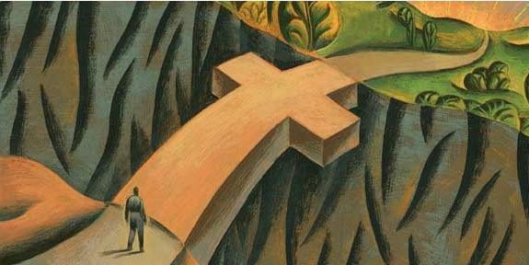
The Cross bridges the gap
We ‘walk across’ by faith

Slide 5
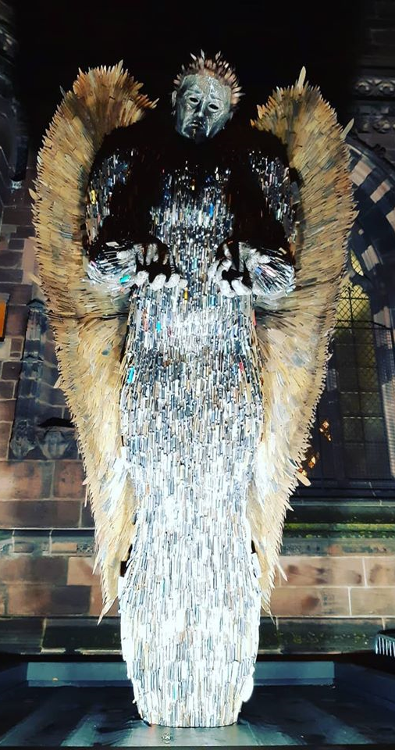
So we have peace…
Peace for ourselves, peace with others, all flowing from peace with God
(v1)

Slide 6
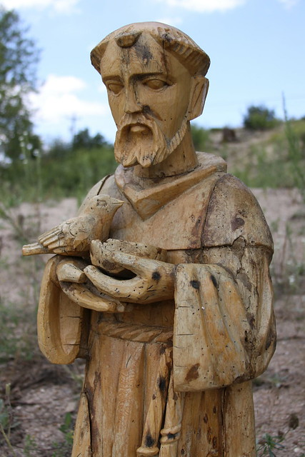
…and we can share this peace with others
St Francis of Assisi’s prayer

Slide 7
So we have reconciliation… (vs10-11)

Slide 8
…and we have a ministry of reconciliation to others (compare 2 Cor 5.19)

