Slide 1
Christ is risen!
He is risen indeed, hallelujah!

Slide 3
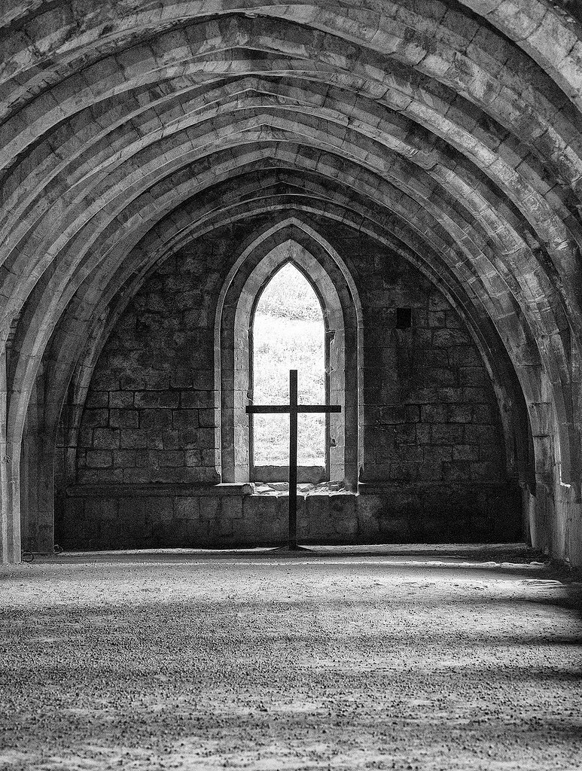
The Greatest Day in History John 20
Come and see…
…the empty cross

Slide 4
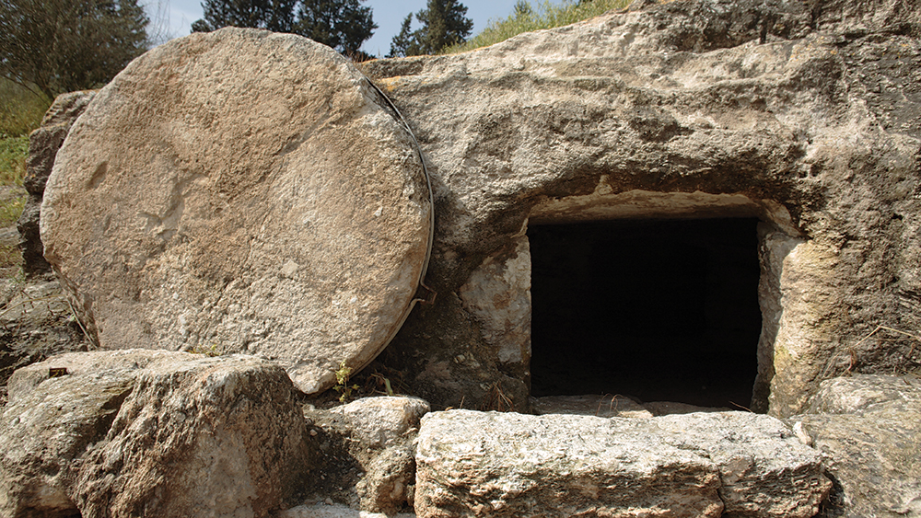
Come and see…
…the empty tomb
See…
…and believe (v8)

Slide 5
Go and tell (v17)

Slide 6
Christ is risen!
He is risen indeed, hallelujah!

