Slide 1
Colossians 3.1-17 Discipleship and holiness
What is the biblical vision, the biblical pattern for holiness?

Slide 2
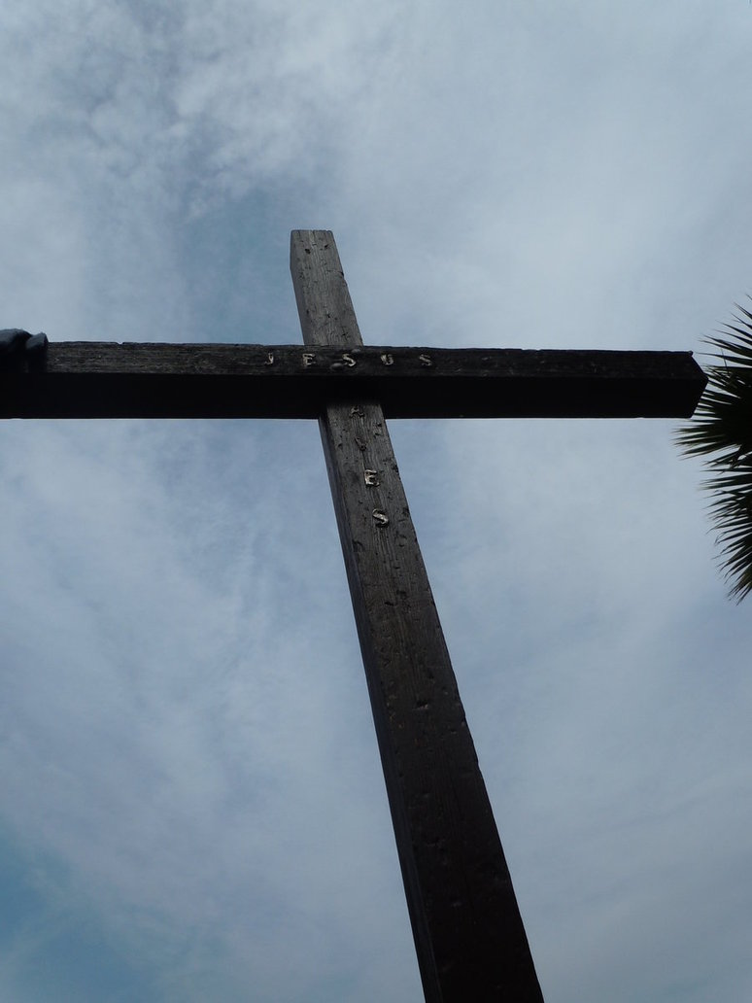
Holiness is reflected in the life of jesus…
vv1-4
Holiness is Christlikeness. It is reflecting his character, his virtues
And it is wonderful

Slide 3
… and in the mission and ministry of jesus
3.1-5
The dying and rising pattern is also the pattern for our growth in holiness

Slide 4
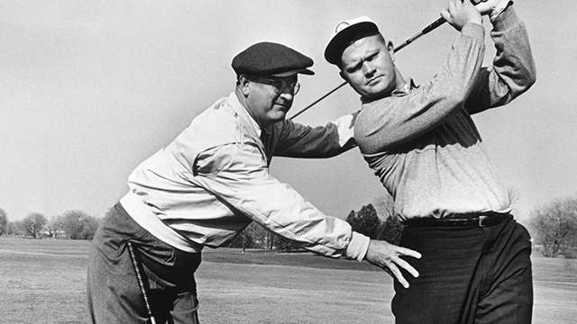
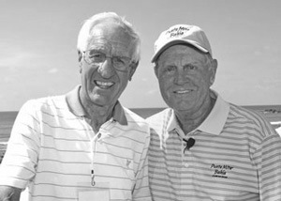
Teach me to play golf!

Slide 5
How do we become holy?
i. God is at work (3.10)
We are being renewed
ii. We are involved
3.1-2, set; 3.5, put to death; 3.7, rid yourselves; 3.12, clothe yourselves

Slide 6
How do we become holy?
A — Avoid.
N — Say No! within five seconds.
T — Turn to something magnificent, like Christ crucified. Think of the ‘expulsive power of a new affection’
H — Hold the pure thing in the mind until the vice is gone.
E — Enjoy the greater pleasure of the promises of God.
M — Move on to meaningful Christ-exalting activity.

Slide 7
How do we become holy?
iii. We will never be perfect (v 13, bearing with one another, forgiving one another)…
… but aim high
Act the miracle…

Slide 8
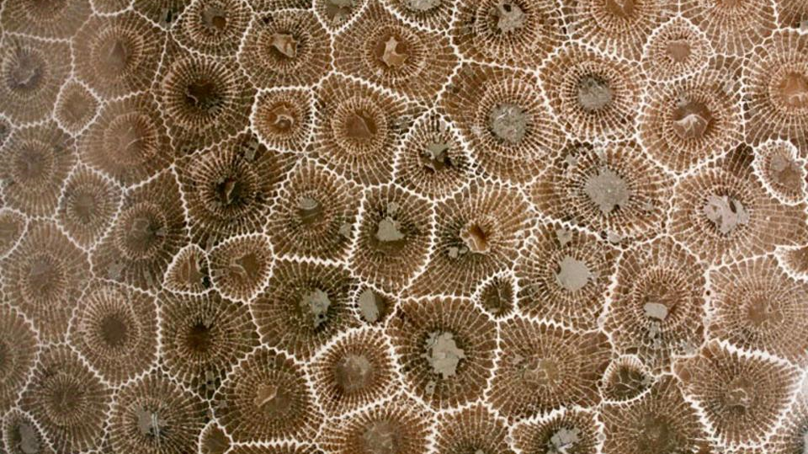
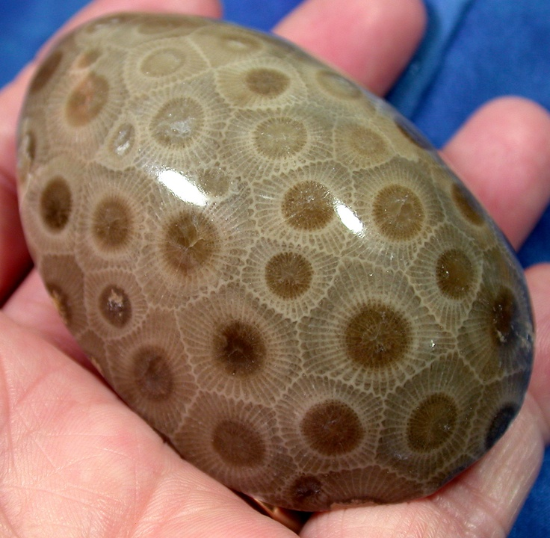
Where is god challenging us to act the miracle?
What do we need to put off and what do we need to put on?

