Slide 1
“Whatever Happens…”
Philippians 1:27 – 2:4
Paul in Prison – 1627 - Rembrandt

Slide 2
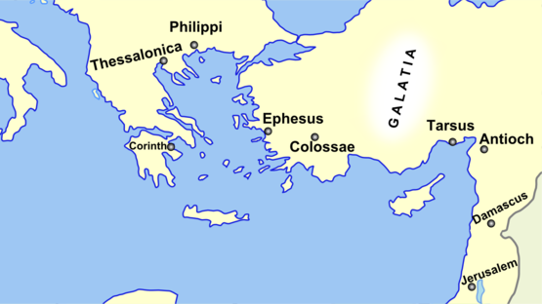
Credit Lisa Burgess
Philippi
42 BC – Antony and Octavian defeat ‘republicans’ Brutus and Cassius
Octavian made Philippi a ‘colony’ – Rights and privileges of mainland Italy
Philippians fiercely proud of Roman status/culture
Wealthy – On East-West trade route

Slide 3
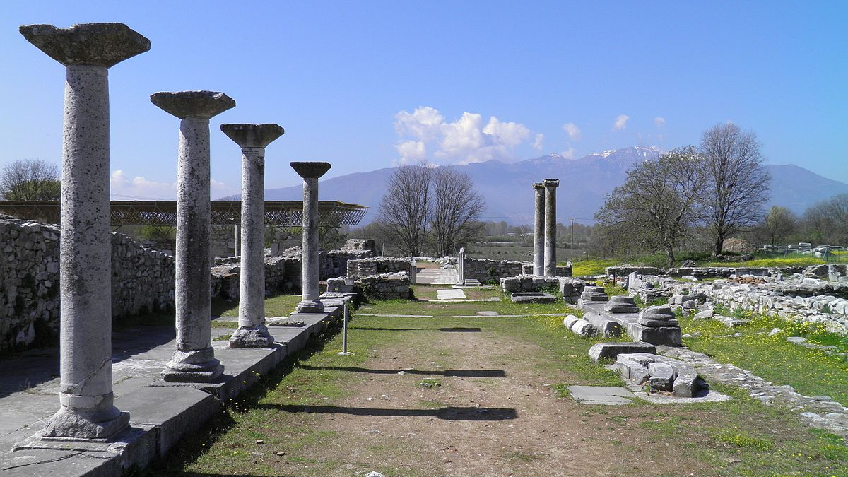
Roman Religion
Traditional Mythology from Greek (Jupiter/Zeus etc.)
Educated preferred philosophy
Mysticism/spirituality from East (Mithras etc.)
Emperor worship began during Augustus 63 BC - 14 AD
One Key Principle: Be a good citizen, loyal to Rome
Forum of Philippi – Credit C Raddato

Slide 4
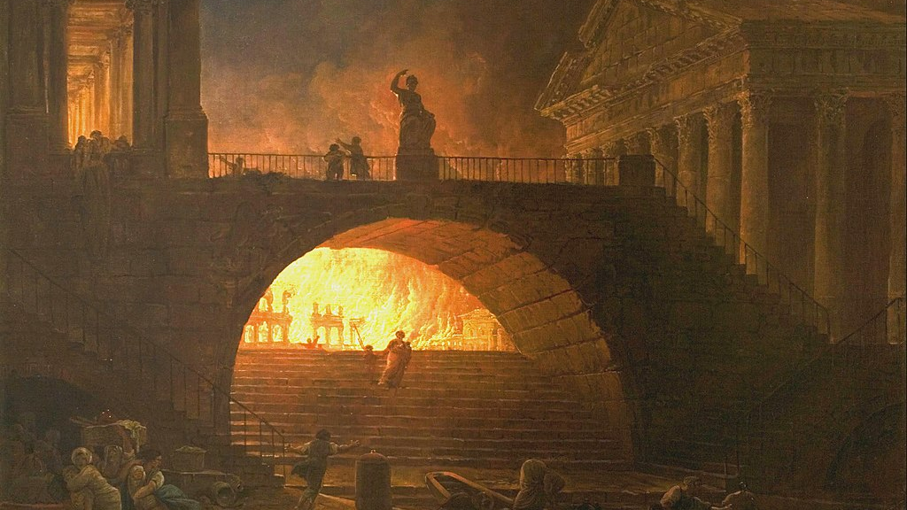
Opposition
Philippian Church Founded
~AD 50
Letter to Philippians
~AD 58-61
~AD 52
Equal to Judaism
Acts 18:12-17
AD 64
Nero blames Christians for Fire of Rome
AD 70
Jerusalem Destroyed
AD 81-96
Domitian asked worship as ‘god’, ‘lord’
Local persecution: Money [Acts 16, 19] – Disloyalty to Rome [Acts 17]
Pressure to conform: To be a ‘good citizen’ – Loyal to Rome
64 AD Fire of Rome – 1785 – Hubert Robert

Slide 5
Philippian Church
Many Roman Christians
Some Jewish Christians
Female leaders [Acts 16]
Opposition [1:29]
Conform to Roman culture?
Adopt Jewish worship? [3:1-10]
Saint Lydia of Thyatira – Credit Eikonografos

Slide 6
Dilute Gospel to be a ‘good citizen’
‘Gospel of Works’ to gain exemptions for Judaism?
Saint Lydia of Thyatira – Credit Eikonografos

Slide 7
What should the church do?
“…our citizenship is in heaven” [3:20]
“…conduct yourselves in a manner worthy of the gospel of Christ” [1:27]
“politeuomai” – “act as a good citizen”
Paul in Prison – 1627 - Rembrandt

Slide 8
What should the church do?
“…our citizenship is in heaven” [3:20] – Our identity is as God’s people
Gospel sets our standards
Contrast “good Roman citizen” with “good citizen of heaven”
Not always opposition – Fruits of the Spirit [Gal 5:22-23]
Paul in Prison – 1627 - Rembrandt

Slide 9
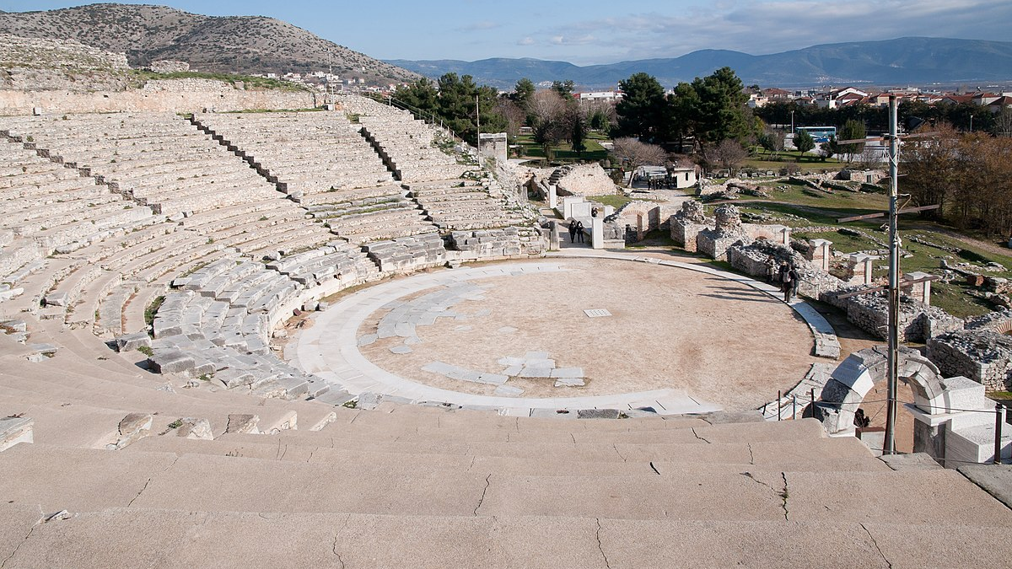
Pressure to Conform vs. Inspiration and Discipleship
Church should be different to society
Teach and encourage correct doctrine – Accountability (bands)
Encouragement and inspiration not pressure or coercion
Look to Jesus and Gospel truth [2:1]
Encouragement from unity in Christ
Comfort from Jesus’ love [John 13:34-35]
Fellowship with Spirit
Tenderness and Compassion
Father, Son and Spirit – Source of our love, unity, strength and purpose
Theatre of Philippi – Credit Wikimedia

Slide 10
How do we do this?
God’s power – Our action [2:1]
Worship Jesus together
"Has it ever occurred to you that one hundred pianos all tuned to the same fork are automatically tuned to each other? They are of one accord by being tuned, not to each other, but to another standard to which each one must individually bow. So one hundred worshippers meeting together, each one looking away to Christ, are in heart nearer to each other than they could possibly be were they to become "unity" conscious and turn their eyes away from God to strive for closer fellowship.“ – A W Tozer
Forum of Philippi – Credit C Raddato

Slide 11
How do we do this?
God’s power – Our action [2:1]
Worship Jesus together
Think about others first [2:3-4]
Talk / Ask / Share about Jesus [Deut 6:4-9]
Pray – “What can I pray for?”
Love other things less
Make time
Church is God’s family
Forum of Philippi – Credit C Raddato

Slide 12
What will other people think?
‘religiosity’ – ‘fundamentalists’ – ‘extreme’
It doesn’t matter – Knowing Jesus is better [3:7-11]
A lot of the time, it will be positive [Gal 5:22-23]
Unity, love and purpose testifies to the Gospel [1:28, John 17:20-23, 1 John 4:11-12]
Paul in Prison – 1627 - Rembrandt

Slide 13
“Whatever Happens…”
Stand firm in Gospel truth [1:27]
As one, without fear [1:27-28]
Testify to the Gospel and our status as God’s people
“…let us not love with words or speech but with actions and in truth” [1 John 3:18]
Paul in Prison – 1627 - Rembrandt

