Slide 1
Embracing Adventure Acts 16
Following Jesus
Centrality of the Bible
Engaging in Mission
Embracing Adventure
Faithful in Prayer
Notes:
Series examining our DNA.
SPT next week

Slide 2
Embracing Adventure - Acts 16
Notes:
Ex SAS, polar
Polar explorer
Seven marathons in seven days on seven continents
Controversial in this county. Why?
Doesn’t like Yorkshire people and would not choose one to be part of his team!
‘The only people I would not even look at are people from Yorkshire’
Outrageous. You can’t say that! As an incomer I think it’s outrageous. What many of you must think…
All Age talk – throw things
Not at the screens!
If he were to come here we would welcome him warmly.
Some people think adventure is not for us. Not for people in Yorkshire, who are based in Yorkshire.
We can think that adventure is for others not for us.

Slide 3
Responsive to the Holy Spirit (vv6-10)
Notes:
Notice Paul wasn’t waiting around for such guidance. There were on the move, looking for opportunities for God. Not the case in Athens – Acts 17. His heart was moved and he just proclaimed the message. There was no direct guidance of the type we see here. But when very specific direction came he responds.
Luke, the writer of Acts joins the team (see the transition from v8 to v10). This is where Luke steps in and joins the adventure himself.
Join with what God is doing and get on board with that. Missio Dei – the mission of God. God is already at work by the Spirit, touching people’s lives, leads and prompts us to join in with what he is already doing and what he wants to do.
Our response can be exactly the same as Paul’s here. We don’t need to wait, but we do need to be attentive and receptive.

Slide 4
Proclaim and Pray (vv13-15)
Notes:
Tell the story
Purple the imperial colour; likely to have been rich.
‘worshipper of God’ – worshipped the Jewish God, the one true God. Not fully converted to Judaism. No synagogue, probably not the ten men needed to have one.
Paul daringly goes to the place of prayer
We need courage sometimes. Just a bit more boldness.
Example of home group. People on street corners. Not helpful. but we need more boldness.
But we do need more boldness.
God opened her heart. What an extraordinary phrase. Place of prayer sets this in the context of prayer and worship.
We are to proclaim and we are also to pray

Slide 5
The Element of Risk (vv16-24)
Notes:
There is invariably a pushback when Christianity is on the advance. There’s spiritual warfare, an uproar, a flogging and imprisonment.
Danger of Christianity being ‘safe’. Because of our turbulent times we look for security only. God does give security but then launches us out on an adventure of faith, that will take into an uncertain turbulent world and will involve significant risk.
Reflection

Slide 6
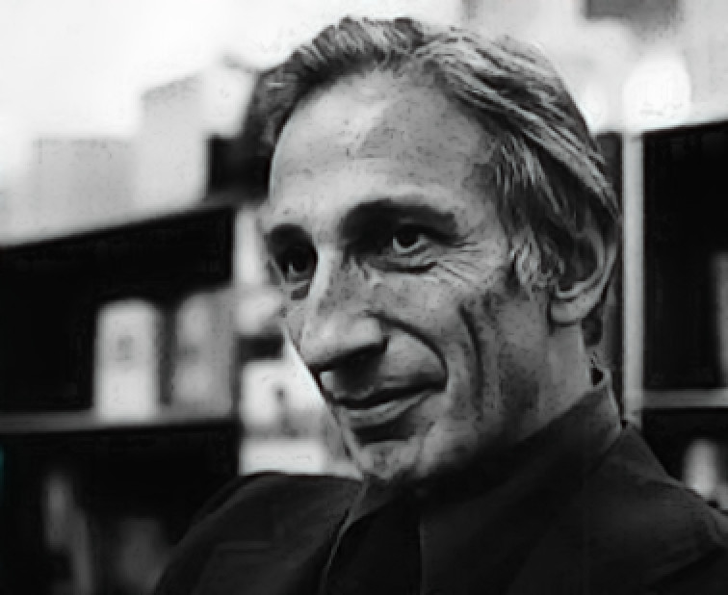
Praise in the battle! (v25)
Telling an alternative story
Notes:
Paul and Silas are telling an alternative story
We don’t need to climb Everest or head to the Sahara. Ivan Illich. Tell an alternative story. Our attitude to money, or career, our attitude to tragedy. Office politics, uncertain times. Do we tell an alternative story.
We can tell an alternative story right where we are.

Slide 7
Responding to the Opportunities (vs 29-34)
Notes:
God’s transforming grace.
The jailor is rescued and he and his whole family experience transformation. He takes a huge risk, but this is now life in colour

