Slide 1
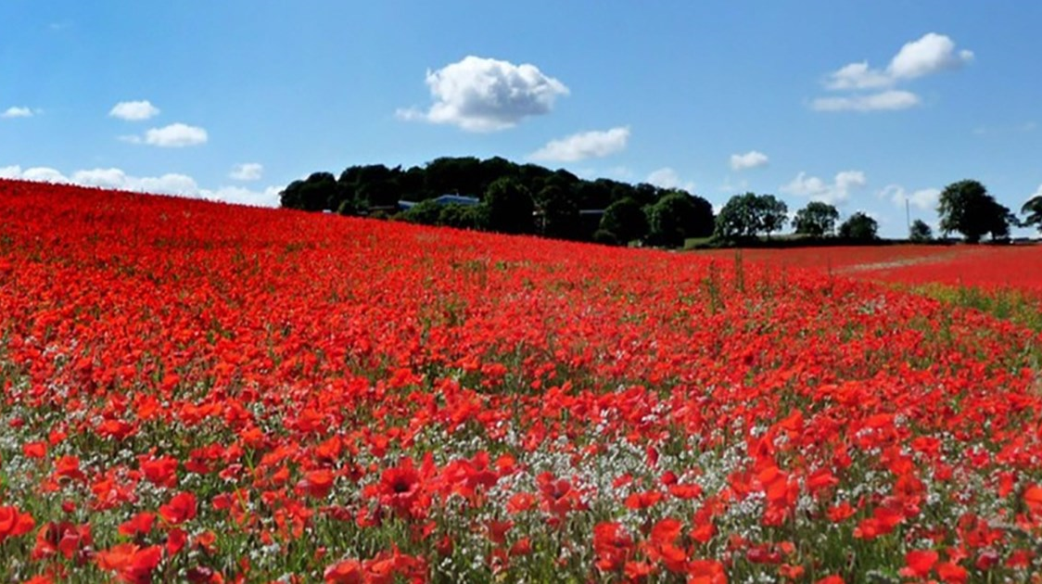
Colossians 1.15-23 discipleship and sacrifice

Slide 2
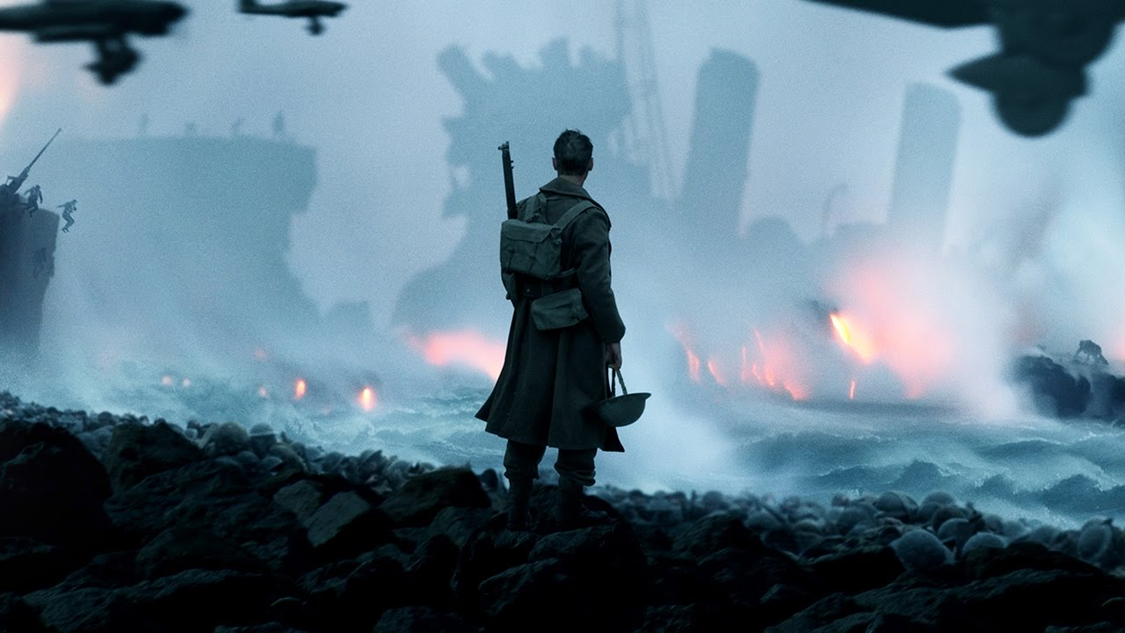

Slide 3
Christ is supreme
In
…Creation (vv15-17)
…The church (v18)
…New Creation / Salvation (v20)

Slide 4
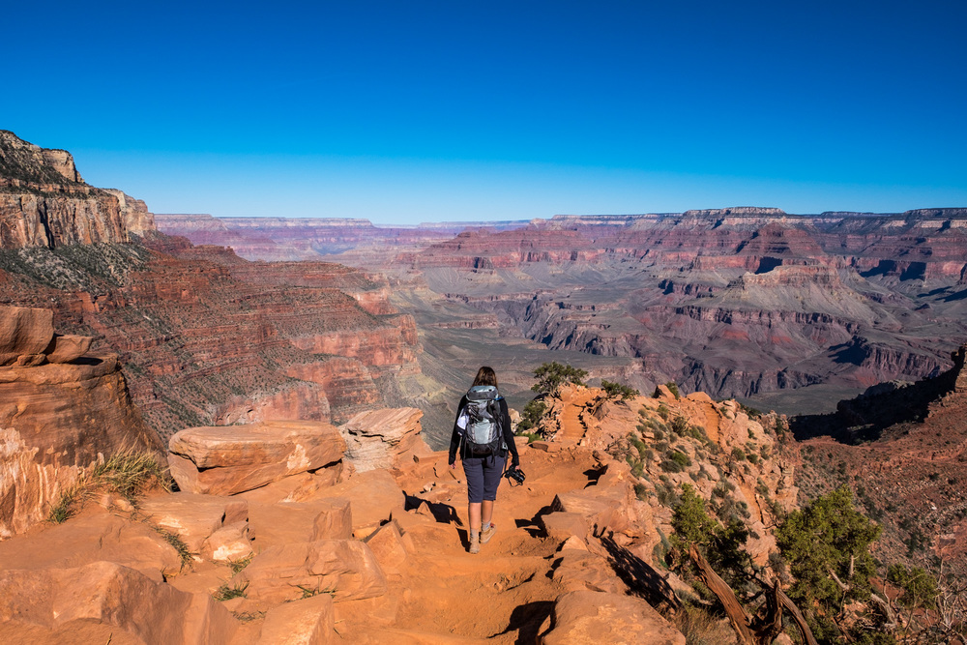
Christ is supreme in salvation vv20-22
Alienated, enemies, evil (v20)
We are separated from God

Slide 5
Jesus has bridged the gap and made it possible to be reconciled (v20)

Slide 6
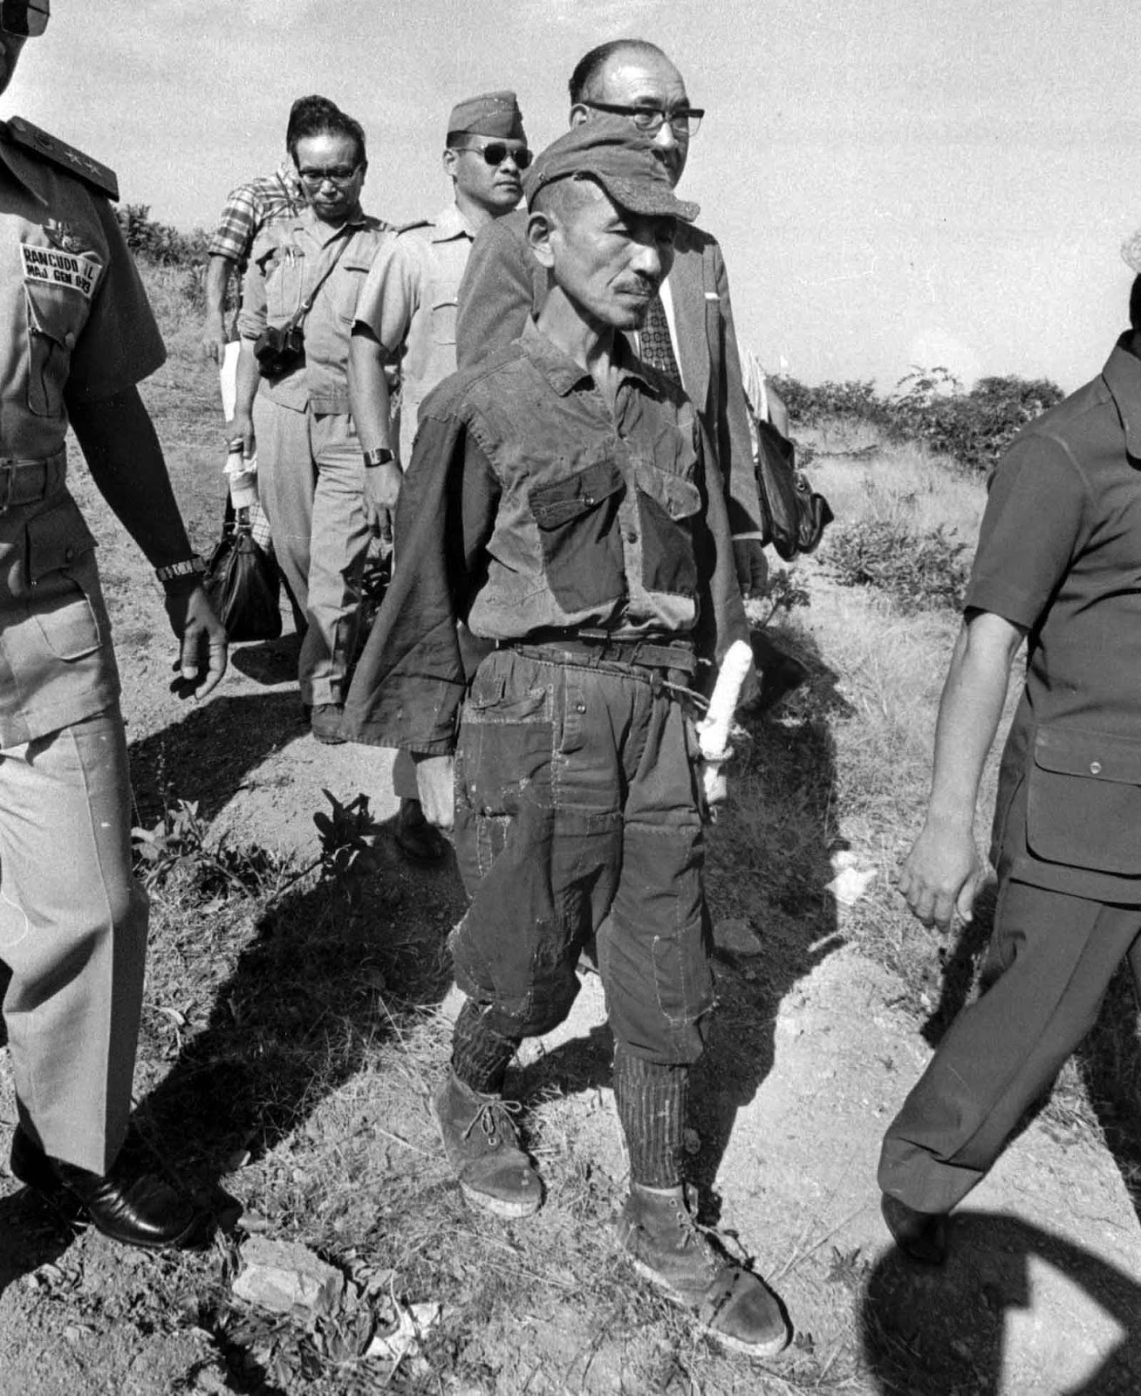
War is over…
if we want it

Slide 7
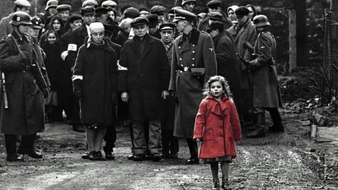
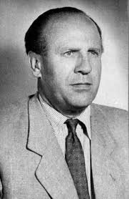
Servants of the gospel (v23)

