Slide 1
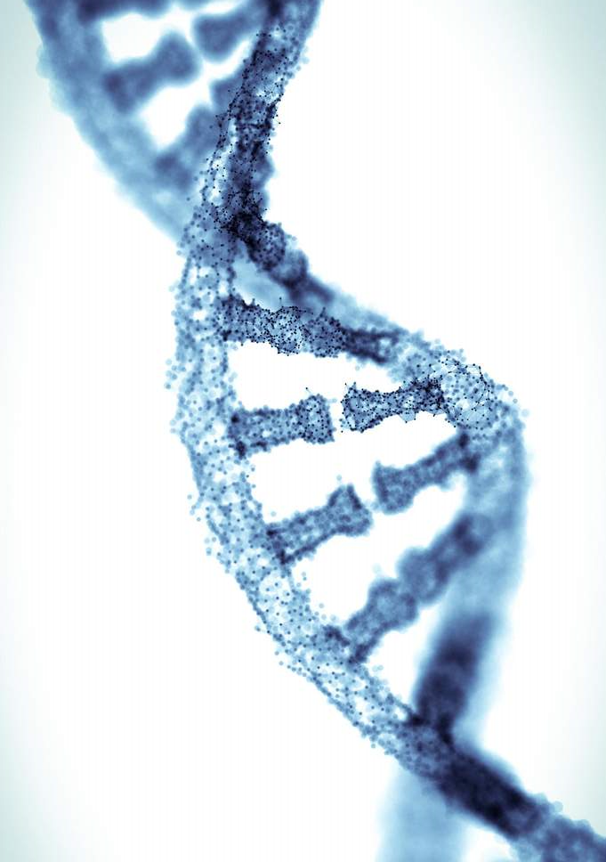
Our values, our DNA
Following Jesus
Centrality of the Bible
Engaging in Mission
Embracing Adventure
Faithful in Prayer
Notes:
Over the past weeks, in different gatherings and in small groups, we’ve been reflecting on some values as a church. Essentially our DNA, the things that are vital to us.
Following Jesus; Centrality of the Bible; Engaging in Mission; Embracing Adventure; Faithful in Prayer
In many ways they’re straightforward. Many gospel churches have similar values, sometimes expressed in different ways.
That’s a positive. If we are coming up with things that are radically different from any other church, that’s concerning. Jesus is the same yesterday and forever, the gospel is God’s power to save in any age. It’s what our forebears called ‘the old, old story’ which we are called live and proclaim. These are tried and trusted gospel values. We can have confidence as we seek to live these out.
The one that’s got a slightly different ring. Leadership Mentor ill (v. brief).
But SPBC at its very best.
At its best we take risks of faith as we move forward together. We embrace adventure in the cause of the gospel.
That’s so important. It may be the old, old story, but it’s a new culture, that continues to change rapidly. Social commentators talk about an ‘accelerated culture’ when describing the world we live in. The only constant is fast paced, disorientating change. We need to consciously embrace adventure, take risks of faith, if we are going to share the never changing gospel with an ever changing world.
These are offered to the church.

Slide 2
Faithful in Prayer Psalm 119. 161-176
Notes:
Psalm 119 is not normally thought of as a Psalm whose central theme is prayer.
Rather, it’s considered a Psalm about the Bible. It certainly is about Scripture, speaking of its perfection. But it’s also very much a prayer. The majority of phrases in our vvs are direct speech to God. vv161-63. Read.
In fact this Psalm has much to teach us about prayer.
We can ask the question, ‘what does it mean to be faithful in prayer?’ and see what the Psalm teaches us, especially the vvs we read.

Slide 3
1/ Shaped by God’s word (e.g. vs 166-168)
Notes:
This Psalm is a prayer but it’s also about the Bible and that’s appropriate, because the two go together.
vv166-67. Notice, ‘follow’, ‘love’ and ‘obey’.
‘Pray as you can, not as you can’t’
Wherever we are on our journey, God hears us. Just pray, just speak out to God what’s on your heart.
But God does want to change us and grow us in prayer.
Sometimes we end up praying for our own selfish desires. God wants to move us on, and he does this through his word.
Headingley evening Gathering. Looking at People in Prayer. Mainly OT, Abraham, Nehemiah, David. Their priorities were very different from ours.

Slide 4
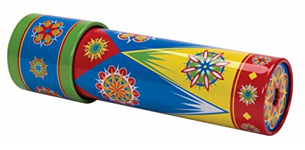
2/ Praying different prayers
Notes:
Kaleidoscope

Slide 5
Praise (e.g., vs 164, 171), thanksgiving (v 165), confession (v 176), intercession (e.g., vs 169, 171)
Adoration
Confession
Thanksgiving
Supplication (see v 170!)

Slide 6
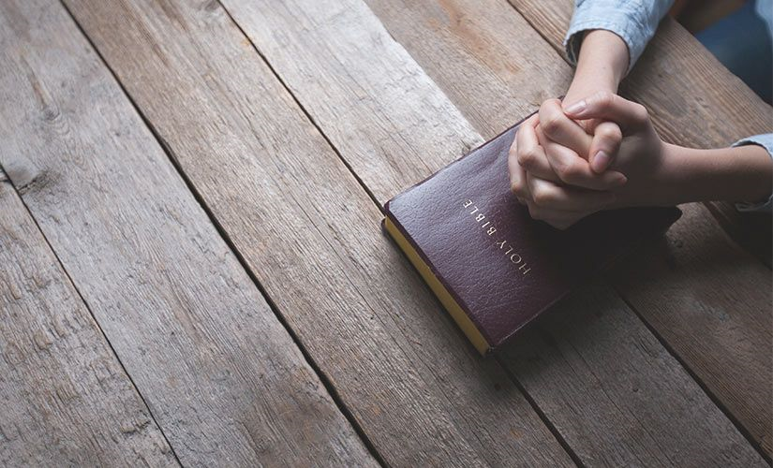
Contemplation is also important (vs 161-162)
Reverent fear and rejoicing
Pausing, reflecting…
Notes:
If we do this, we get material for spoken prayer

Slide 7
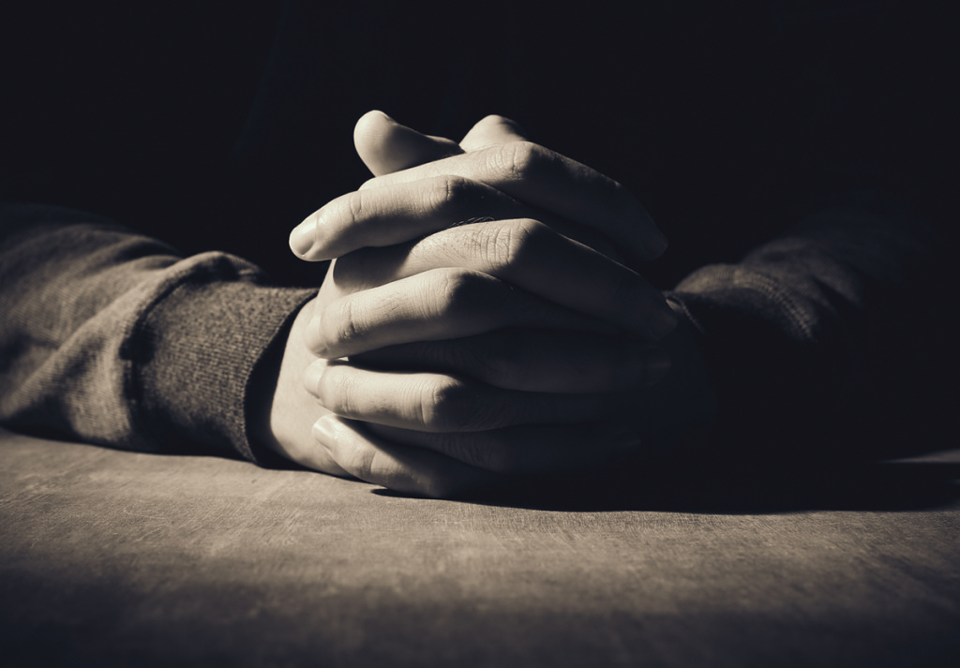
3/ Disciplined (v 164)
Seven times a day!
Pray without ceasing (1 Thess 5.17) but we can only do this if we’re disciplined

Slide 8
4/ Heart to Heart Engagement
The Psalmist loves prayer because he loves God

Slide 9
Can I be honest with you? I'm actually not that into prayer, It’s Jesus I’m into, so we talk. I don't believe in the power of prayer. I believe in the power of God. So I ask for his help. A lot.

