Slide 1
South Parade Together. Feb 2019
Notes:
We believe God is doing something here.
But this firstly refers to the new thing of the gospel. It’s already here.

Slide 2
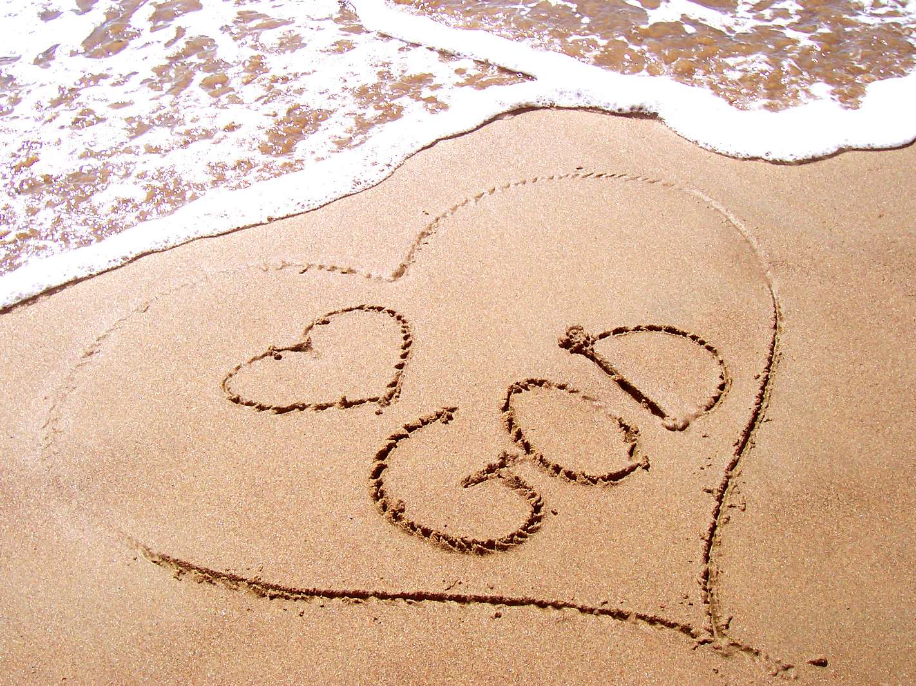
Passion for God; love for people; heart for mission
God has a passion for us and he calls us to be passionate about him in return

Slide 3
Saved…
Redemption (v1)
Ransom (v3)
Called by name (v1)

Slide 4
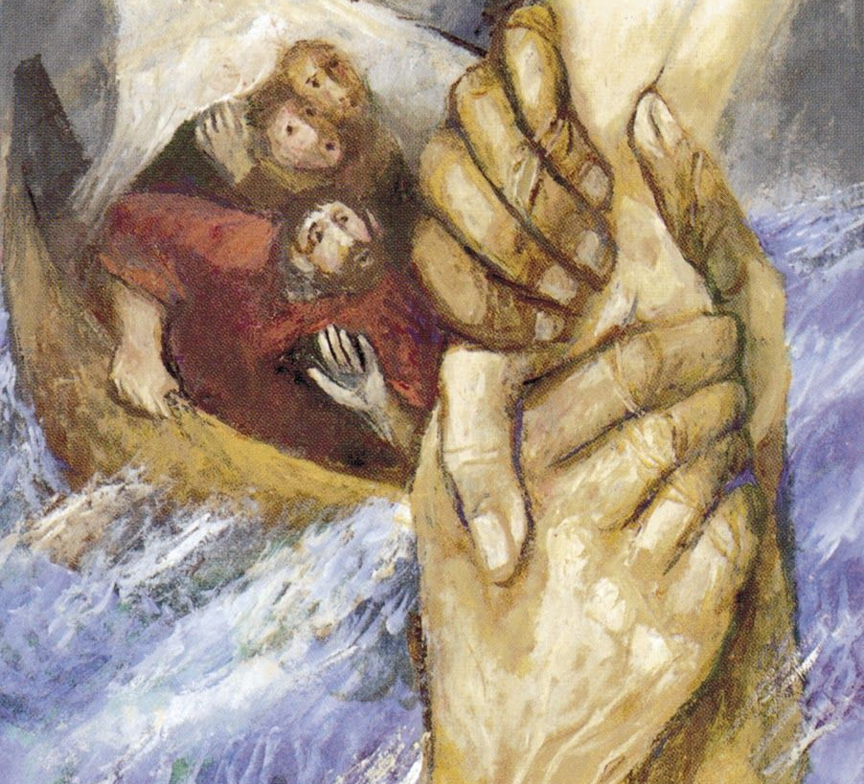
...and sustained
Sieger Koeder ’Stronghold’
vv2-3;
Matthew 14
Notes:
God’s love is a saving love; and his love keeps us through the storm.
Sometimes God takes us out. More often he is with us in the storm – he takes us through.
Apply
Just pause and receive this.
Cragg, Connect Headingley. Deacon, Elder, MT. Serve in worship, welcome, finance

Slide 5
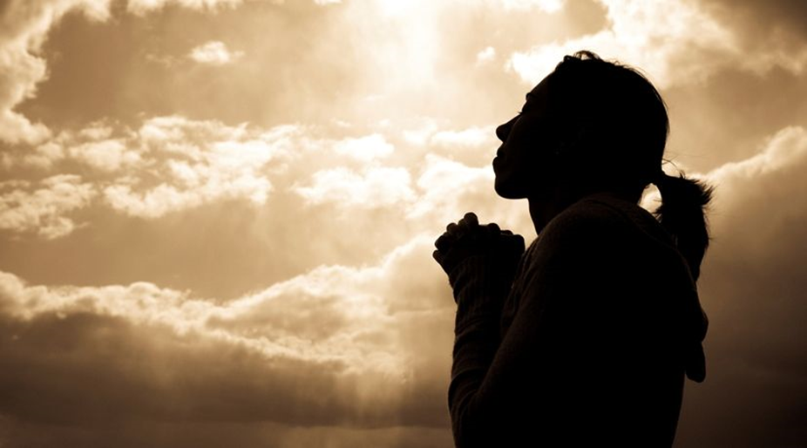
Passion for God; love for people; heart for mission
Our call is respond with a passion for him, his people, his mission

Slide 6
Passion for God
v21 ‘…that they may proclaim my praise’
Notes:
Hearts, hands and voices to God.
Mark Hirst – worship before witness.

Slide 7
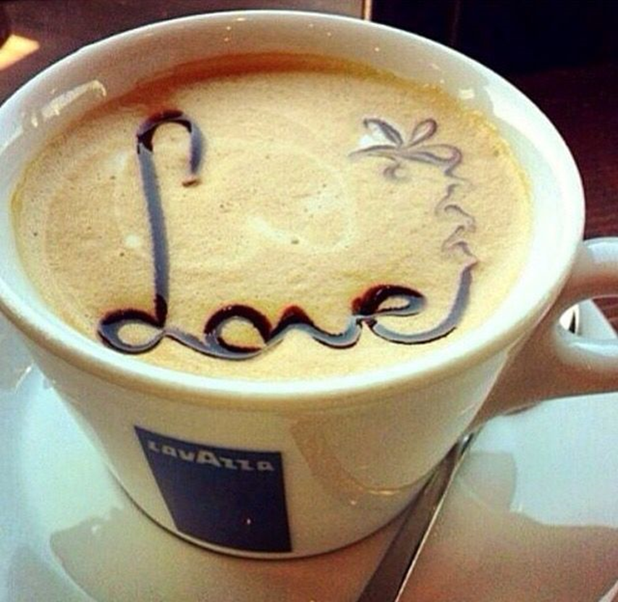
Love for People
vv6-7 show the breadth of God’s love

Slide 8
Heart for Mission
v10 You are my witnesses

Slide 9
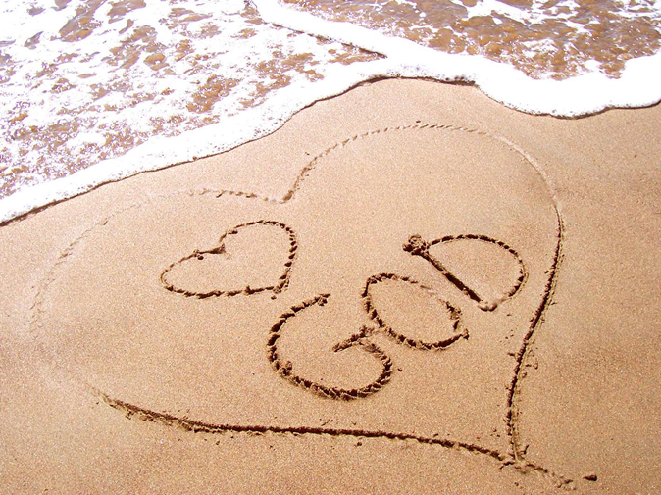
Whole Church Meeting – 24 Jan
Mission Community >> Gathering
One church, three sites, different gatherings
Uniting the work at Headingley under one leadership team
Breakthrough Prayer, third Sunday of the month, Headingley evening

Slide 10
Challenging but realistic budget set
Prioritising disciple making mission
Disciples who make disciples…
Notes:
0.85% follow Jesus.
That doesn’t mesh with this chapter

Slide 11
Concrete, practical changes
Café run here from our Headingley site

