Slide 2
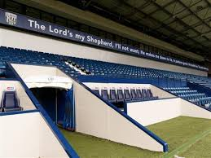
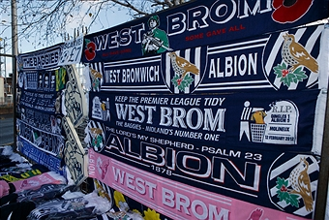

Slide 3
The Lord is my Shepherd, I shall not be in want.
He makes me lie down in green pastures,
He leads me beside quiet waters,
He restores my soul.
He guides me in paths of righteousness for His Name’s sake
Even though I walk through the valley of the shadow of death I will fear no evil,
For You are with me.

Slide 4
my , I shall be in want.
me,
me ,
my soul.
me
I walk through the valley of the shadow of death fear evil,
.

